Slide 1



Business Context
Description: As a Corporate banking customer, to be able to view the Account Balances / Transactions at any point of time. Able to create a Payroll Transaction (PAY) using the available account and interface to Backoffice. Online status update for payments to customer.
Scope of this project: Simplify the payment processing and Account Position to customers.
Diagram:
Access restriction / Availability check before any action.
Account position flow – Format and Specifications
Bank
Customer
Online
Banking
Channel
Payment Creation / Management
Interfacing & Processing
Outward / Inward Interface message formats and status code handling
Online Channel, User to be Validated and Authenticated while login.

Slide 2
List of User Stories
Sr. # | User story | Comments [Must-have/Good-to-Have]
1. | Login to Corporate Channel Application with Validated Credentials | Must Have
2. | Creating of Transaction using an entry screen with validations | Must Have
3. | Quick payment creation using file upload | Must Have
4. | Transaction Management (Print, Edit,… ) Journeys | Must Have
5. | Approval of transaction | Must Have
6. | Interface to Processing engine | Good to have
7. | Status Update and visual display | Good to have
8. | Account Balance & Reporting | Must have
9. | Online balance reporting | Good to have
Good-To-Have: Stretch goals

Slide 3
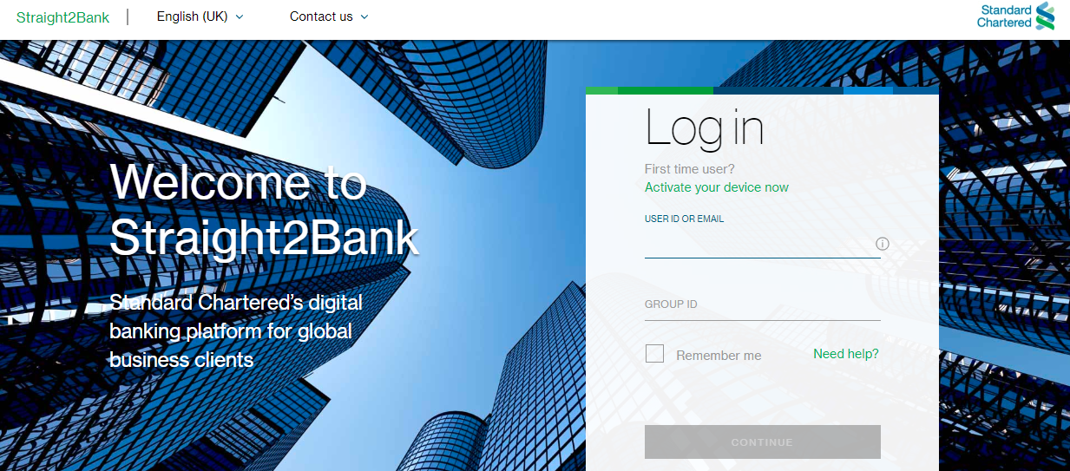
User Story-1
Description
As a User, I want to login to Corporate Online Channel using my credentials, so that I can perform my Transaction / Balance handling.
Acceptance Criteria
Verify that valid credentials are used for login authentication
Proper error message for any failure cases
Verify that account is locked after three (3) failed login attempts.
Screen Mock up

Slide 4
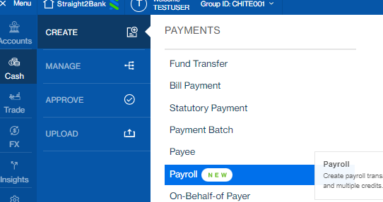
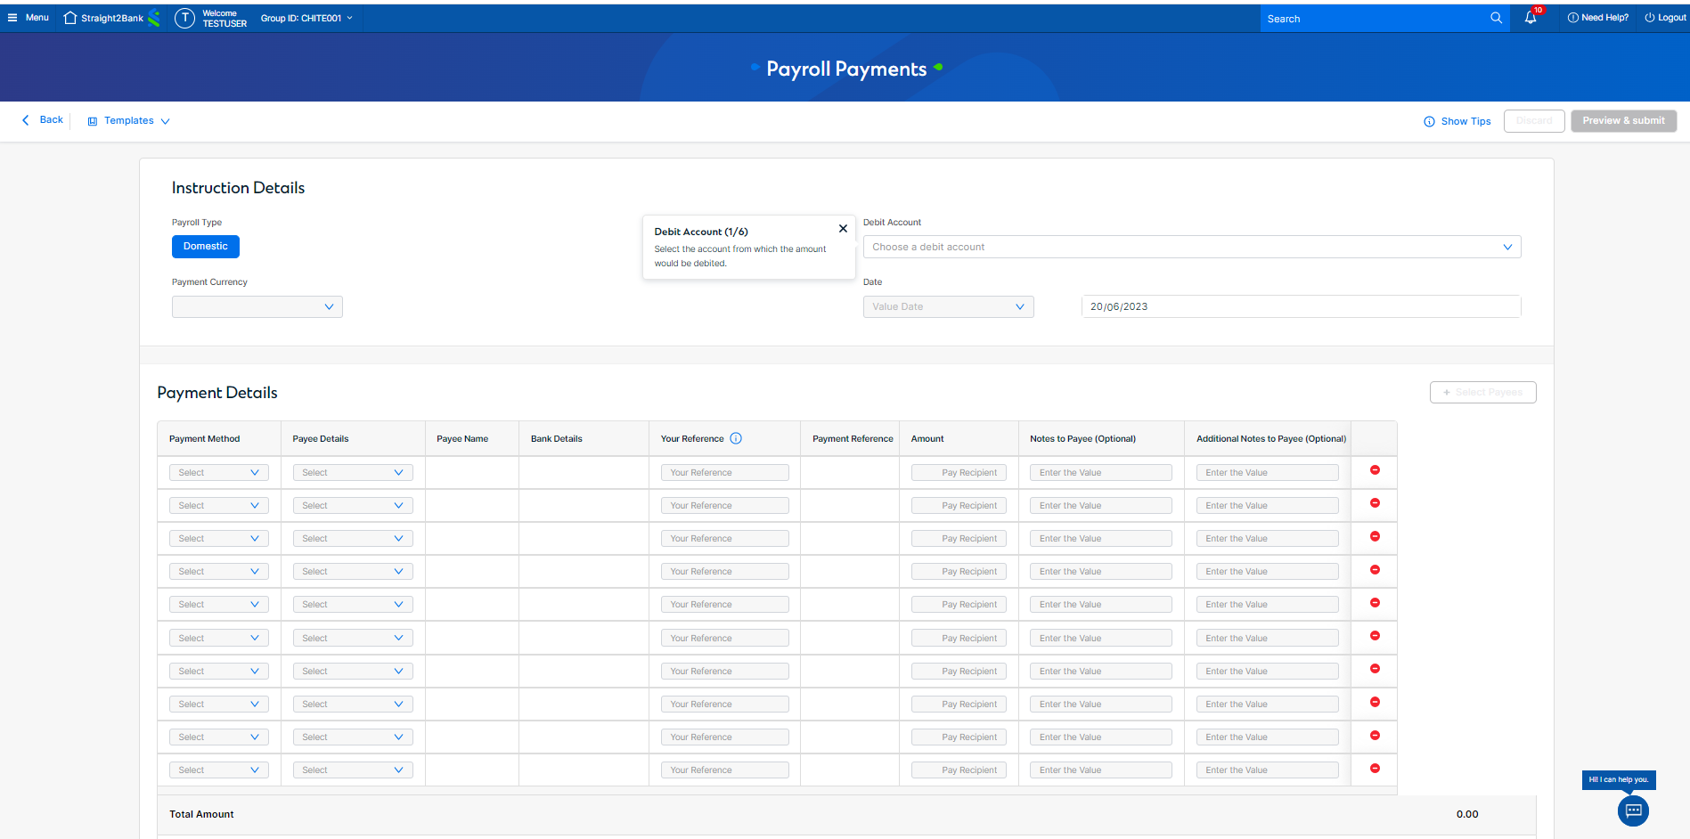
User Story-2
Description
As a User, I want to Create a PAY (Payroll Payment), so that I can transfer fund to my Company employees salary payment.
Acceptance Criteria
Valid Data for every fields to be able to enter by user
Payment Submission for further processing, if all the required input values available
Save as Draft to be available for modify the data in future
Batching to be done for each set of transaction for easy management and Access segregations
Amount in respective Base Currency and Account Currency to be available
Screen Mock up

Slide 5
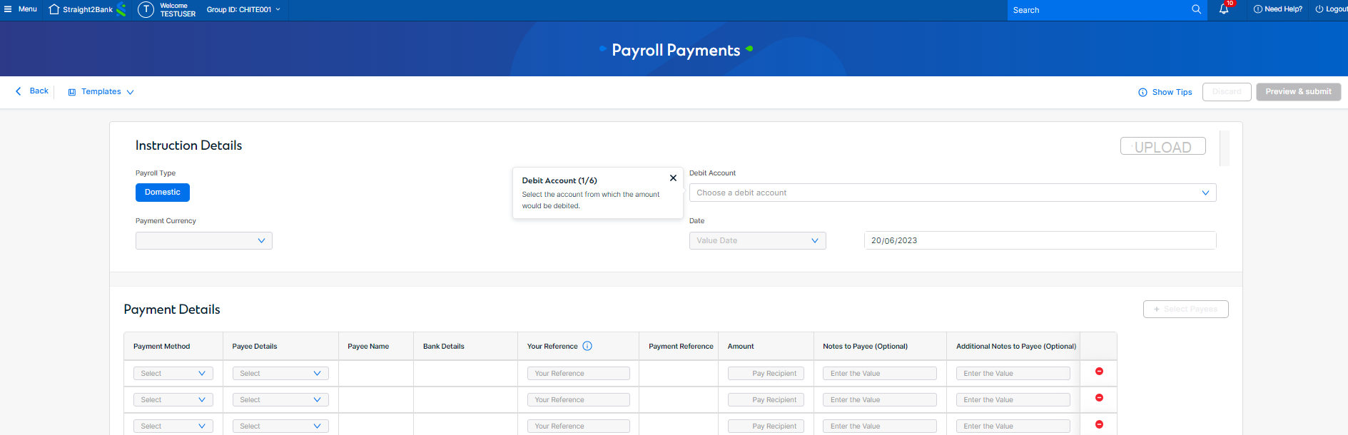
User Story-3
Description
As a User, I want to Create a transactions in a easier way, like in excel, where the data can be populated by keying or copying the key information to create the transactions quickly.
Acceptance Criteria
Valid Data for every fields to be able to enter by user
Payment Submission for further processing, if all the required input values available
Save as Draft to be available for modify the data in future
Screen Mock up

Slide 6
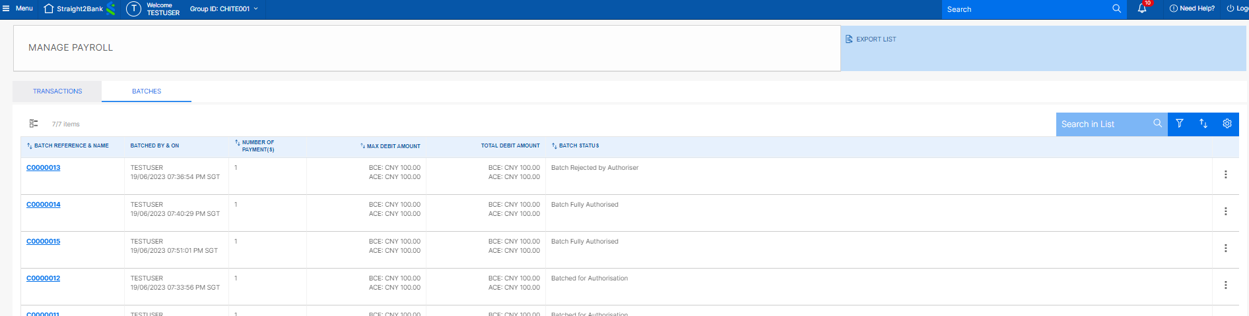
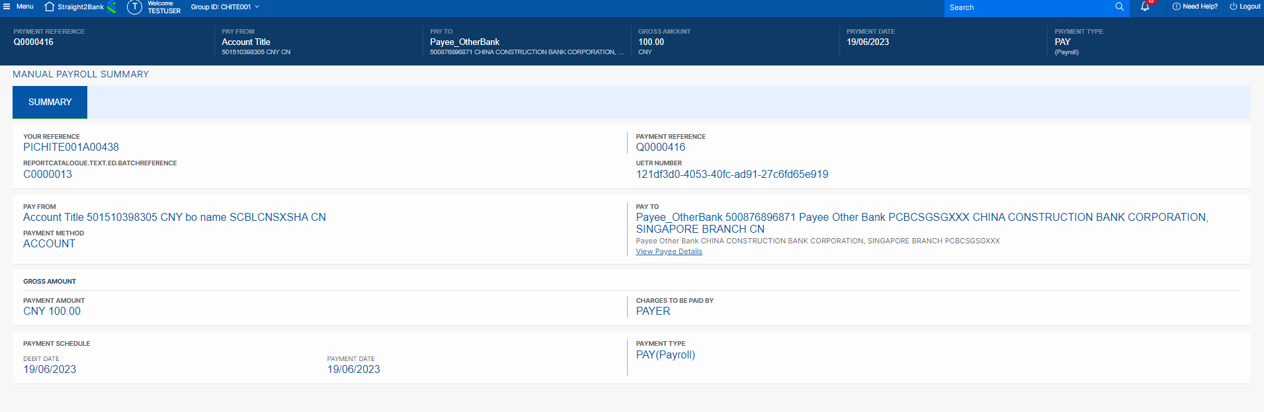
User Story-4
Description
As a User, I want to view all transactions created, so that I can manage my transactions effectively
Acceptance Criteria
All transactions belongs to the user to be displayed in a list
User to be able to take actions for these transactions
Any restriction of access available to be able to apply on the list of transactions and batches
Screen Mock up

Slide 7
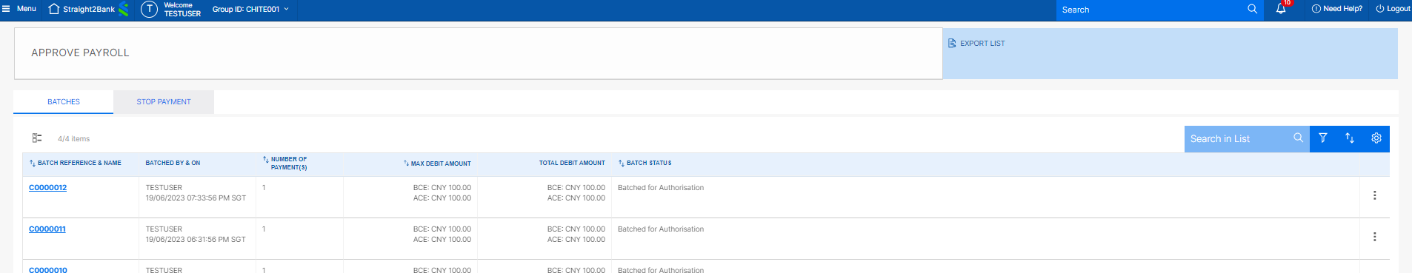
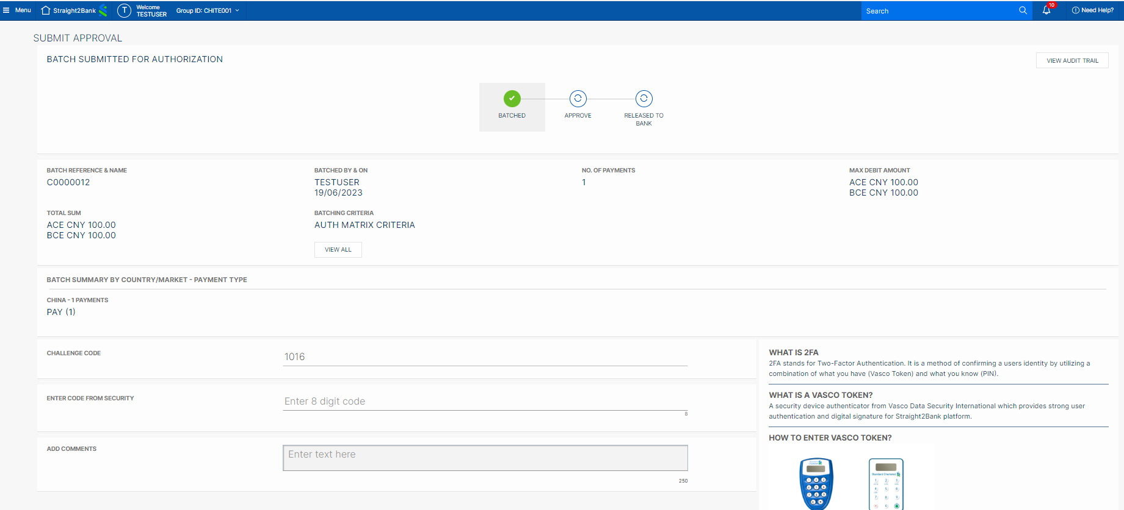
User Story-5
Description
As a User, I want to approve the payment, so that it can get processed.
Acceptance Criteria
All transactions belongs to the user for approval to be displayed in a list
User to be able to take actions for these transactions (Approve / Reject)
Any restriction of access available to be able to apply on the list
Screen Mock up

Slide 8
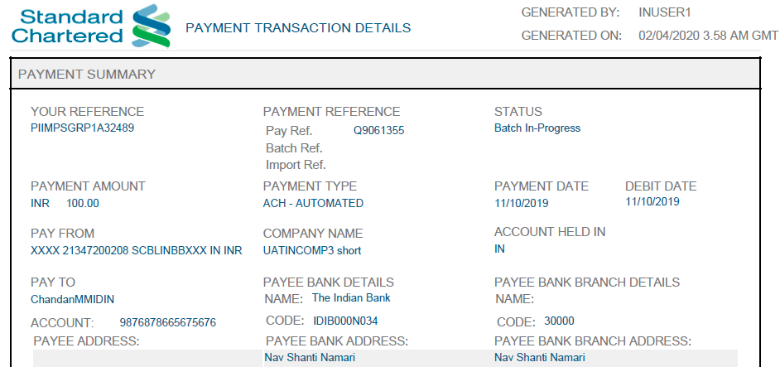
User Story-6
Description
As a User, I want to view the transaction print by using the html preview so that the transaction details can be view quickly.
Acceptance Criteria
Print Transaction details in a user readable format
Multiple transaction should be able to print
Dynamic html preview layout should be able to define
The access restrictions to be done for the transaction / Batch printing based on user access
Screen Mock up

Slide 9
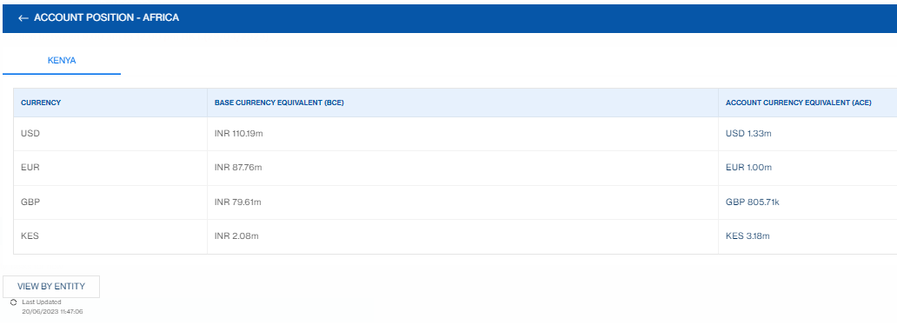
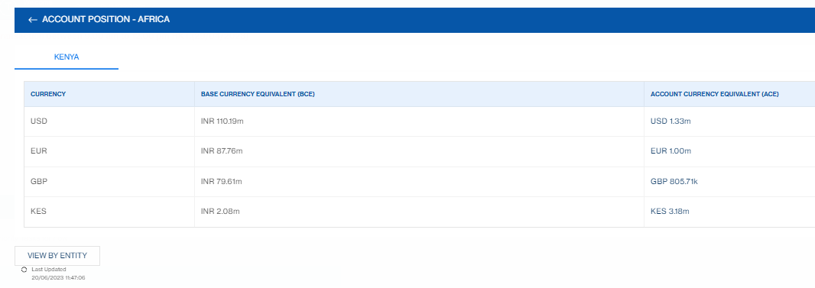
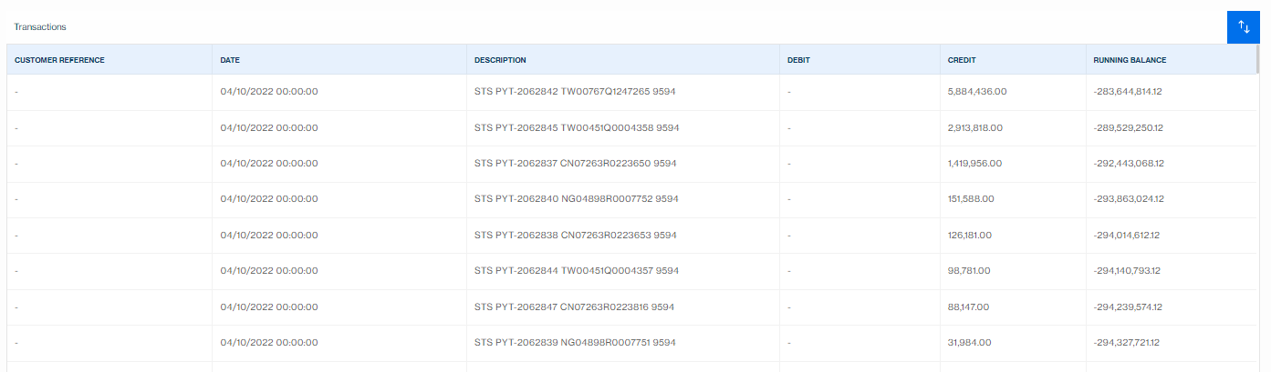
User Story-7
Description
As a User, I want to view the balance and Statement of my account, so that I can manage my account position.
Acceptance Criteria
Accounts along with the balance to be displayed
A drill down to transaction level details to be available for view
Account statement to be able to download or view through selecting the account and the date range
Screen Mock up

